Slide 1
WELCOME

Slide 2
Assalamu Alaikum everyone

Slide 3
Let’s see my biography

Slide 4
Meet MD AMIR HOSSAIN
A Journey Through my Life

Slide 5
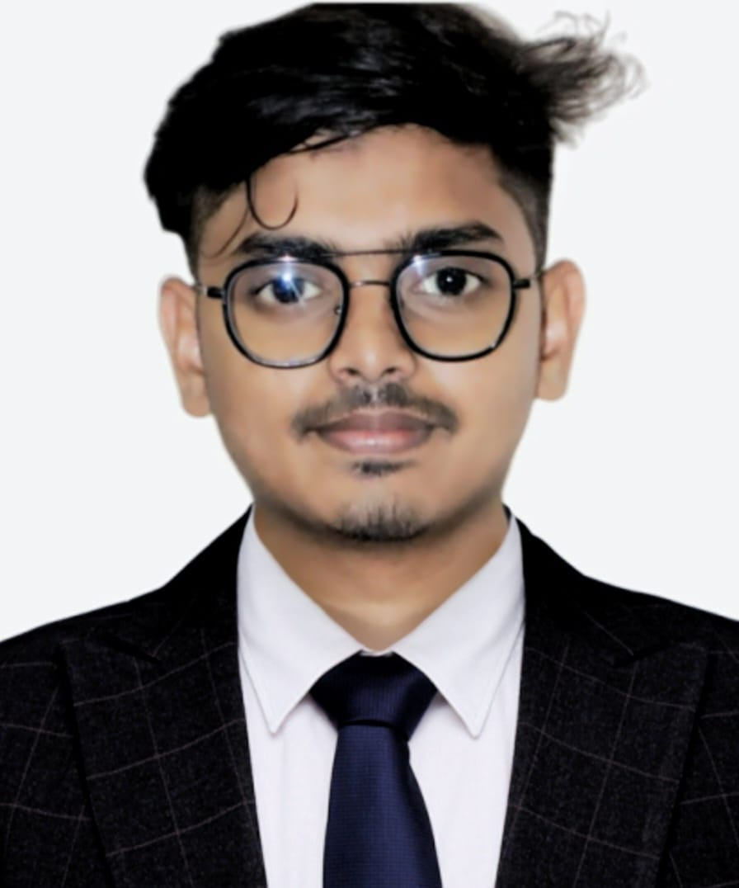
MD AMIR HOSSAIN

Slide 6
Birth and Family
Born in Bahar Kachna Dawaitari in Rangpur. I grew up in a loving family with 5 siblings.

Slide 7
Education
Attended Begum Rokeya University, Rangpur. Where I developed a passion for a better life.

Slide 8
First Job
Start my career at Vivo company as a vivo brand advisor.

Slide 9
Hobbies and Interests
I enjoys sports, traveling, cooking, reading
Family
Not yet married

Slide 10
Volunteer Work
Actively involved in Rangpur city student welfare Association.

Slide 11
Aspirations
Aims to achieve a better life and a better family in the coming years.
Vision
Envisions a future where all of my dreams come true.

Slide 12
Thank you

